Slide 1
Vet Care App

Slide 2
Team Member Name And Project Classification
Team Member Name And Enrollment | Topic Cover By Team Member | Working Hours As A Team
Rupesh Daha - 20SOECE11110 | Layout, SRS, PPT, Backend Coding | 2hr Per Day
Awadhesh Gupta - 20SOECE11095 | Layout, Backend Coding, SRS, PPT | 2hr Per Day
Priya Chaudhary- 20SOECE11096 | Layout, SRS, PPT,Backend Coding | 2hr Per Day
Sharmila Paudel - 20SOECE11115 | Layout, Backend Coding, SRS, PPT | 2hr Per Day

Slide 3
Requirment Of The Project
This application is designed for the farmer and peoples who have domestic animals.
The user can check health condition of their animals and
can contact with vet nary doctor.
The user can also learn about new disease of animals and also get information about how to cure themselves from the victim animals.
The main purpose of the app is
  To provide information about different types of animals disease.
  To Contact with vet nary doctor.
  For student as learning purpose.

Slide 4
Scope Of Project
Display readily viewable information requested by Users.
Assist in the Improvement of waiting time at Animal Care Facilities.
Once released the Software will be Placed in Lollypop on Facility grounds or on Mobile devices.
Students can use as study purpose.

Slide 5
Technology Used In Application
Android Studio
XML (eXtensible Markup Language)
  used to make Front-End Development.
JAVA for Back-End.
Firebase
  (Firestore database)
  (Cloud storage)
Firebase
The Firebase Realtime Database is cloud-hosted.
Data is stored as JSON and synchronized in real
time to every connected client.

Slide 6
Hardware Specifications
Android Version should be more than 8.2
Intel I5, 11th generation processor
Ram 8 GB and above
SSD 256 and above
Android phone

Slide 7
Libraries Use In Application
Firebase Dependency.
Google Mobile Services.
  Auth
  Material Design.
  implementation 'androidx.core:core-splashscreen:1.0.0-beta02'

Slide 8
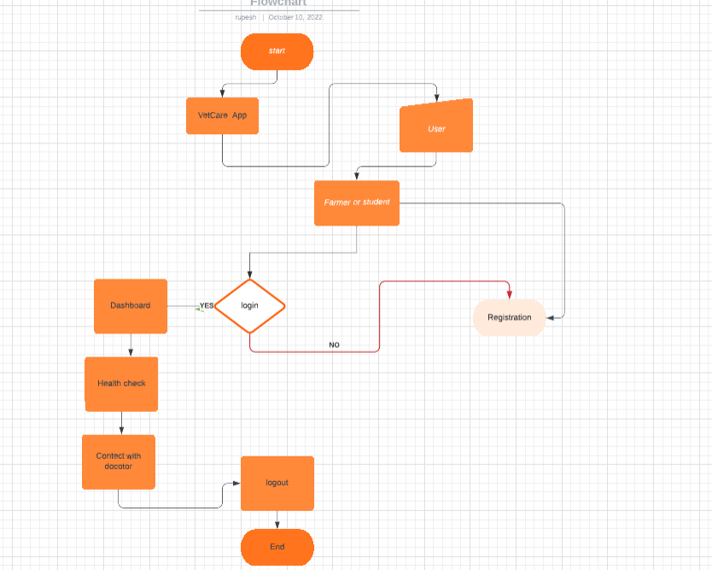
FlowChart
Flowchart shows the connections
between different stages of a process
or parts of a project

Slide 9
Application Prototype Using Figma

Slide 10
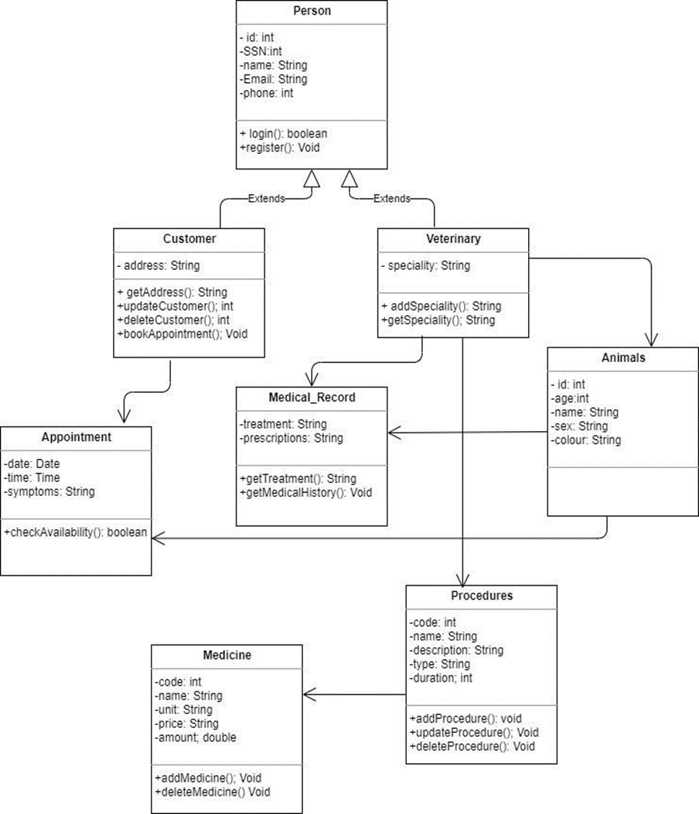
Class Diagram
Class Diagram is a type of static structure diagram
that describes the structure of a system
by showing the system's classes,
their attributes, operations
(or methods), and the relationships
among objects.

Slide 11
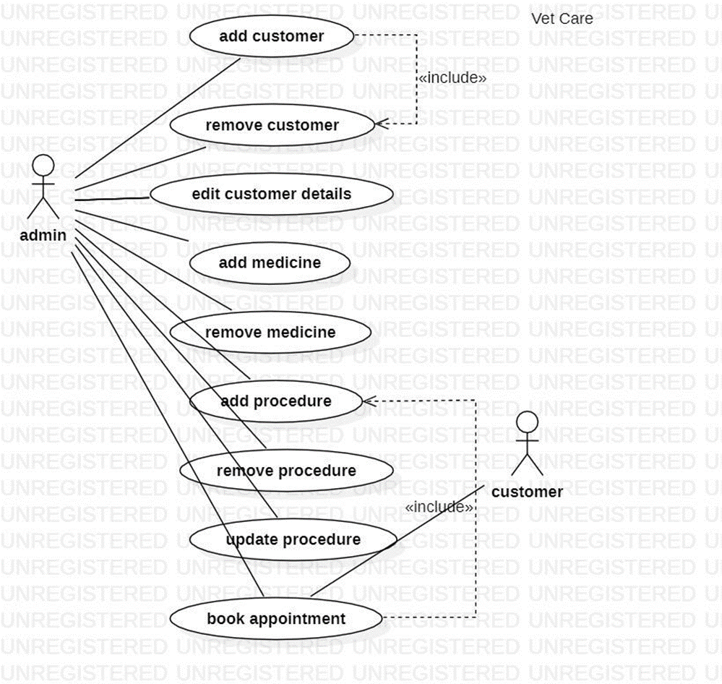
Use Case Diagram
It is generally shown as a graphic
depiction of interactions among
different elements in a system.

Slide 12
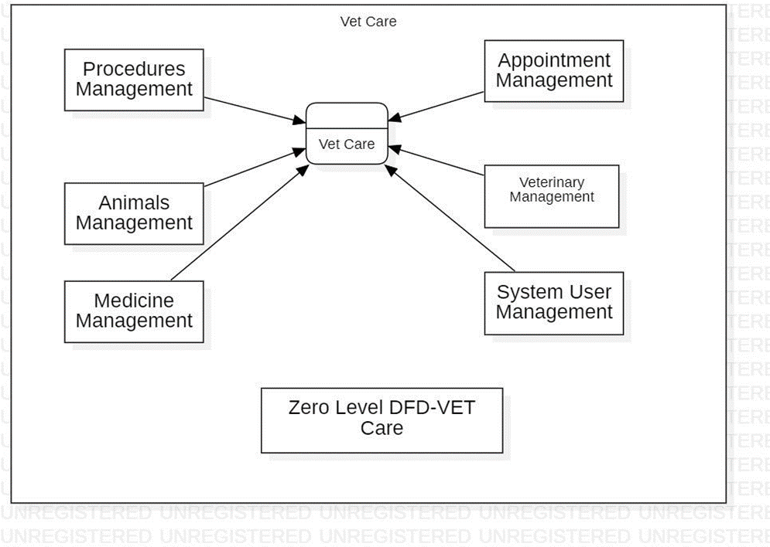
DFD Diagram
DFD Diagram maps out the flow of information
for any process or system.
0

Slide 13
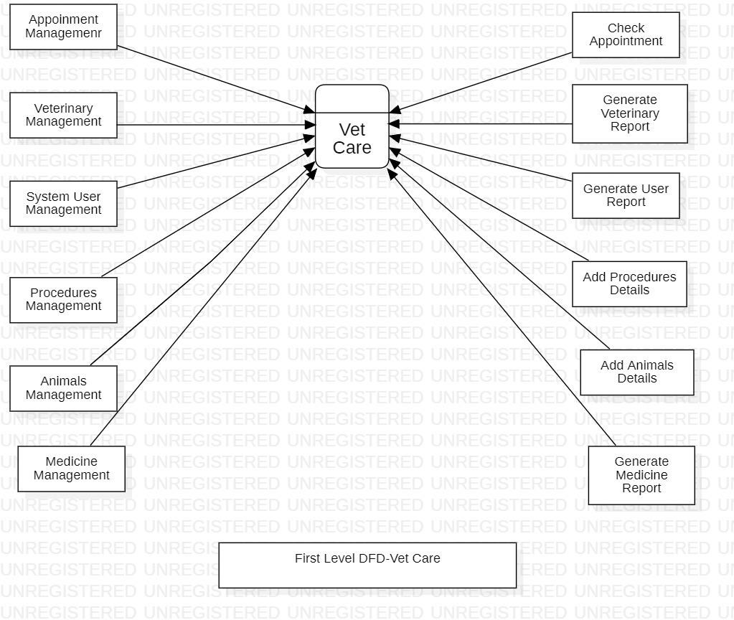
DFD Diagram

Slide 14
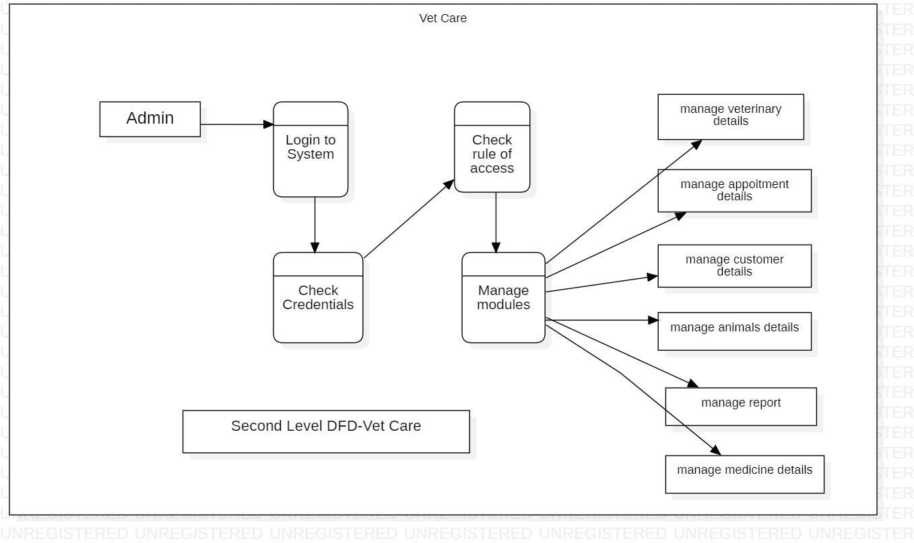
DFD Diagram

Slide 15
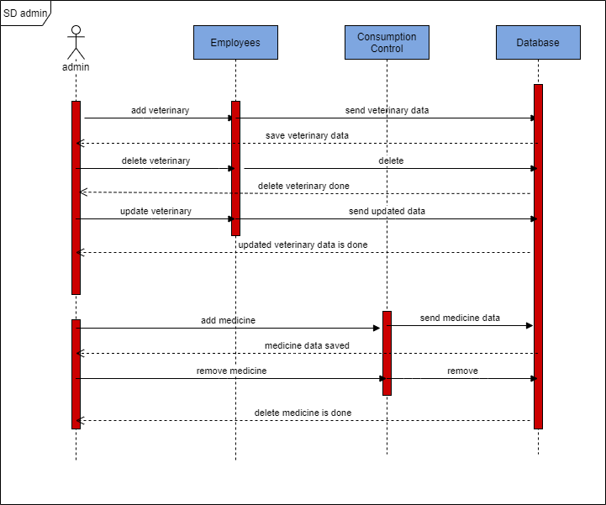
Sequence Diagram
Sequence Diagrams are time focus
and they show the order of the interaction
visually by using the vertical axis of the diagram to
represent time what messages are sent and when.

Slide 16
Functional Requirement
Email, Password Validation.
If the use used tha mobile registration then they have to give the proper OTP for regisrtation.
If the user use the wrong password or username which is not register than it can’t be login.

Slide 17
Limitations
Internet Connectivity Mandatory
Security
Server down
Sometimes the error may occur due to
Intent passing

Slide 18
Future Enhancement
Cover whole India
Linkup with Local Government

Slide 19
Thank You

